Slide 1

Connecticut Traffic Stops
General Assembly Data Science
Adeniyi Harrison

Slide 2
So what are we doing?
Predicting incident outcomes of traffic stops based on driver attributes, location information and other incident meta data
Is DWB (Driving While Black/Brown) a real thing?
Outcome Variable: Police Intervention Disposition (Warning, Ticket or Arrested)

Slide 3
Where is the data from?
Subscribed to “Data is Plural”
Connecticut Data Collaborative
Traffic Stop Data by each police department in Connecticut from Oct 1, 2013 to Sep 30, 2015
Mostly Categorical
Driver Information
Reason for Stop
Result of Stop

Slide 5
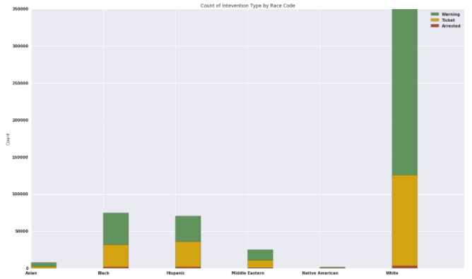
Count of Stops by Racial Groups

Slide 6
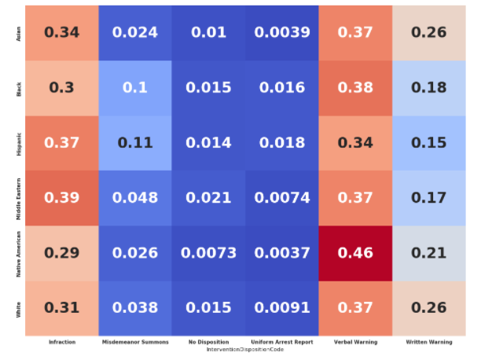
Racial Group and Intervention Result Matrix

Slide 7

Where did we leave off?
Logistic Regression
Outcome Variable: Whether a stop will result in a ticket/arrest or warning
Feature Variables: Race, Sex and Age
Accuracy: 54%

Slide 8
What have I done since?
Google API to convert police departments into geo locations
Scraped Wikipedia Pages to get demographic data to merge to the locations

Slide 9
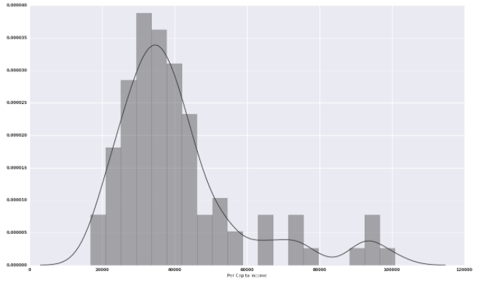
Histogram of Per Capita Income of cities in analysis

Slide 10
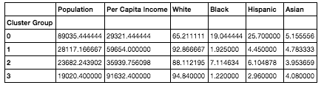
Clustering
Kmeans Clustering
4 Different types of Connecticut Cities
Group 0: Large Population, Low Income City with Large Black and Hispanic Populations (9 Cities, Example: Bridgeport)
Group 1: Medium Population, Medium Income City with Large White Population (12 Cities, Example: Trumbull)
Group 2: Small Population, Low Income City with Small Sized Black, Hispanic and Asian Population (41 Towns, Example: Vernon)
Group 3: Small, Majority White and Wealthy Cities (5 Towns, Example: Darien)

Slide 11
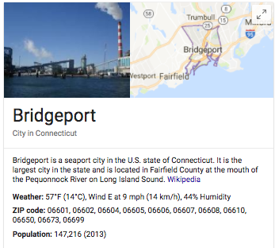
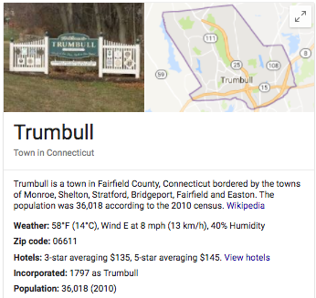
Group 0
Group 1

Slide 12
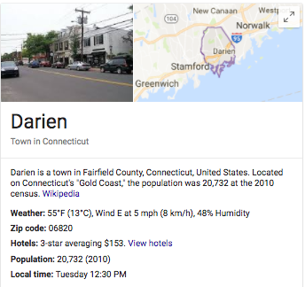
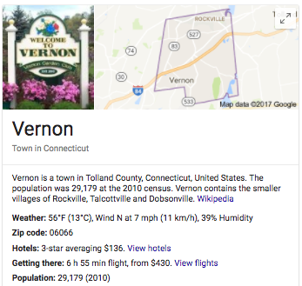

Group 3
Group 2

Slide 13
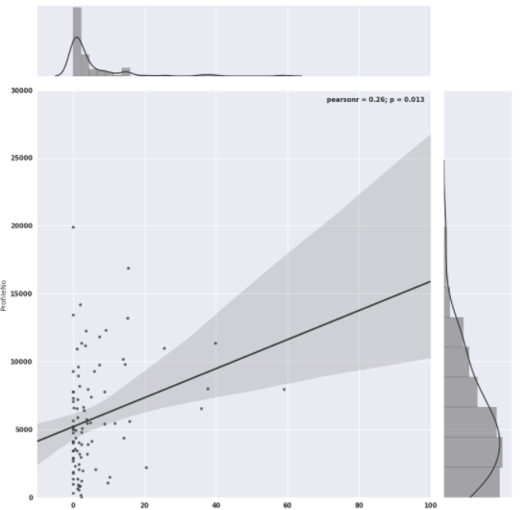
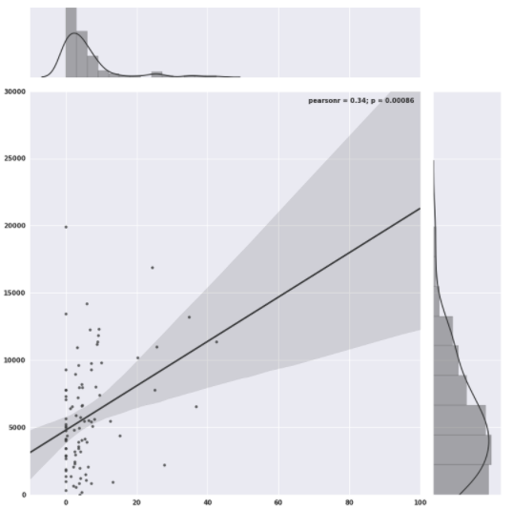
Number of Stops vs. Percentage of Hispanic Population
Number of Stops vs. Percentage of Black Population
R Squared: .26
R Squared: .34

Slide 14
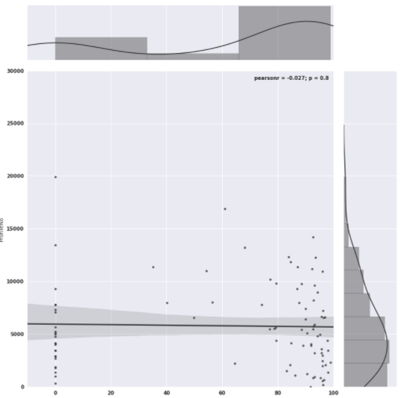
Number of Stops vs. Percentage of White Population
R Squared: -.03

Slide 15
Logistic Regression
Feature Variables: Race Group, Sex, Age, Population, Per Capita Income, Racial Population Percentages
Predicting whether a driver will get a ticket or arrested
Accuracy: 63%
Coefficient Interpretation
Black Drivers are 2% less likely to get a ticket compared to White Drivers
Hispanic Drivers have 12% increased chance of getting a ticket over a White Driver
As a city’s total black percentage population increases by 1 percentage point the chances of any driver getting a ticket increases by 1.17x
Each 1 point increase in Hispanic population the probability is 1.09x

Slide 16
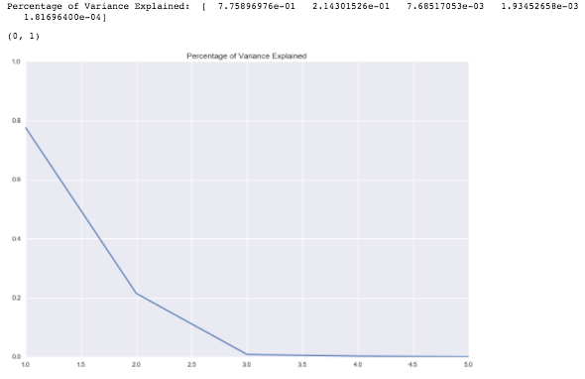
Principal Component Analysis
Feature Variables: Race, Age, Sex, Day of Week, Month ,Resident Indicator, Stop Reasoning, Stop Duration, Vehicle Searched, Vehicle Towed, Demographic data (50 Variables total)

Slide 17
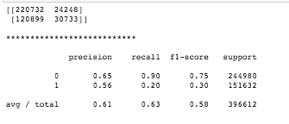
Principal Component Analysis
Logistic Regression with 2 Eigenvalues
No Improvement from original Logistic Regression
Accuracy: 63%

Slide 18
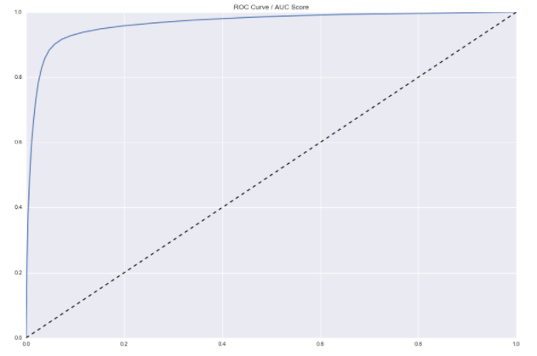

Random Forest Classifier
Feature Variables: Race, Age, Sex, Day of Week, Month ,Resident Indicator, Stop Reasoning, Stop Duration, Vehicle Searched, Vehicle Towed, Demographic data (31 Variables total)
The model is 78% accurate at predicting whether a driver will be ticketed or arrested once pulled over

Slide 19
End.

